Slide 1

Food Deserts in the United States
Venkatesh Nagarjuna
Manoj Kodihalli Venkatesh

Slide 2
Introduction
Source: USDA Food Access Research Atlas
Definition: Food deserts are areas with limited access to affordable and nutritious food.
Objectives:
Analyse the factors contributing to food deserts across U.S. census tracts.
Identify patterns and high-risk areas by analysing demographic and food access variables.
Goal: Propose federal-level policy recommendations to increase food access

Slide 3
Dataset Preparation
Started with USDA Food Access Research Atlas and Food Environment Atlas
Used a pre-defined data dictionary based on our SMART questions
Dropped irrelevant variables (e.g., administrative codes, crop acreage, 20-mile access)
Removed columns with missing values > 10%
Retained key variables: income, SNAP, vehicle ownership, low access percentages

Slide 4
SMART Questions
Where are food deserts most geographically concentrated across the U.S., and how do these concentrations differ between urban and rural census tracts?
What demographics and socioeconomic factors are linked to food deserts?
How are food deserts related to health issues like obesity and diabetes?
Can we develop a predictive model that accurately identifies high-risk areas likely to be or become food deserts based on social and economic indicators?
What national policies could reduce food deserts based on our findings?

Slide 5
SMART Question 1 Where are food deserts most geographically concentrated across the U.S., and how do these concentrations differ between urban and rural census tracts?
According to the USDA definitions, a "food desert" is typically a low-income tract that also has low access to supermarkets based on established distance criteria.
Target Variable: 'LILATracts_1And10'
Notes:
Joyce

Slide 6
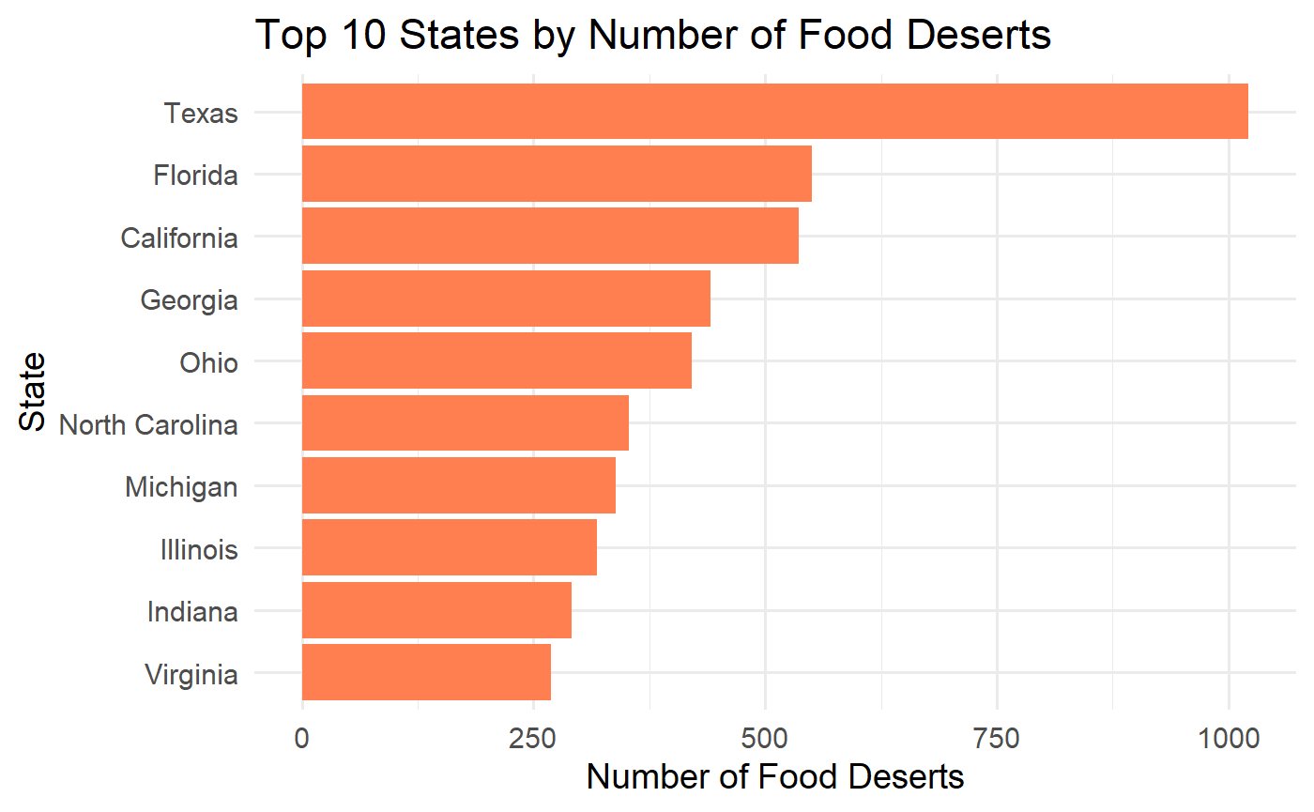

Slide 7
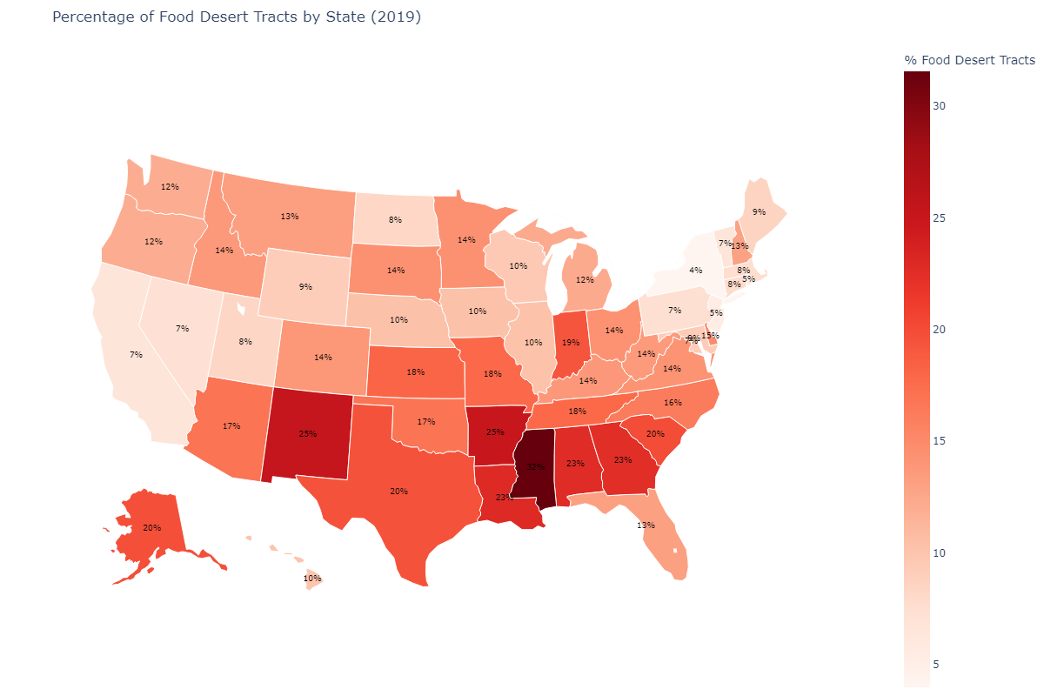

Slide 8
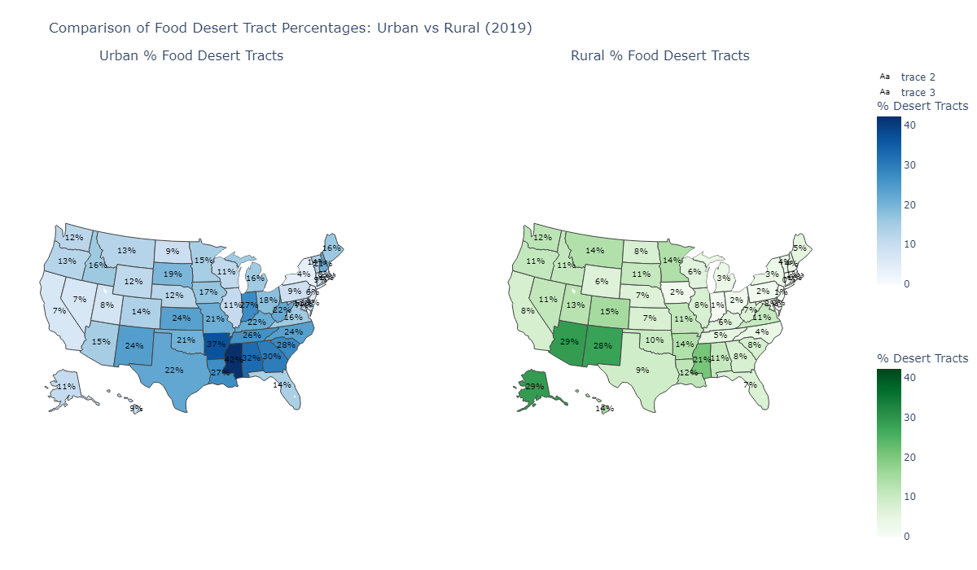

Slide 9
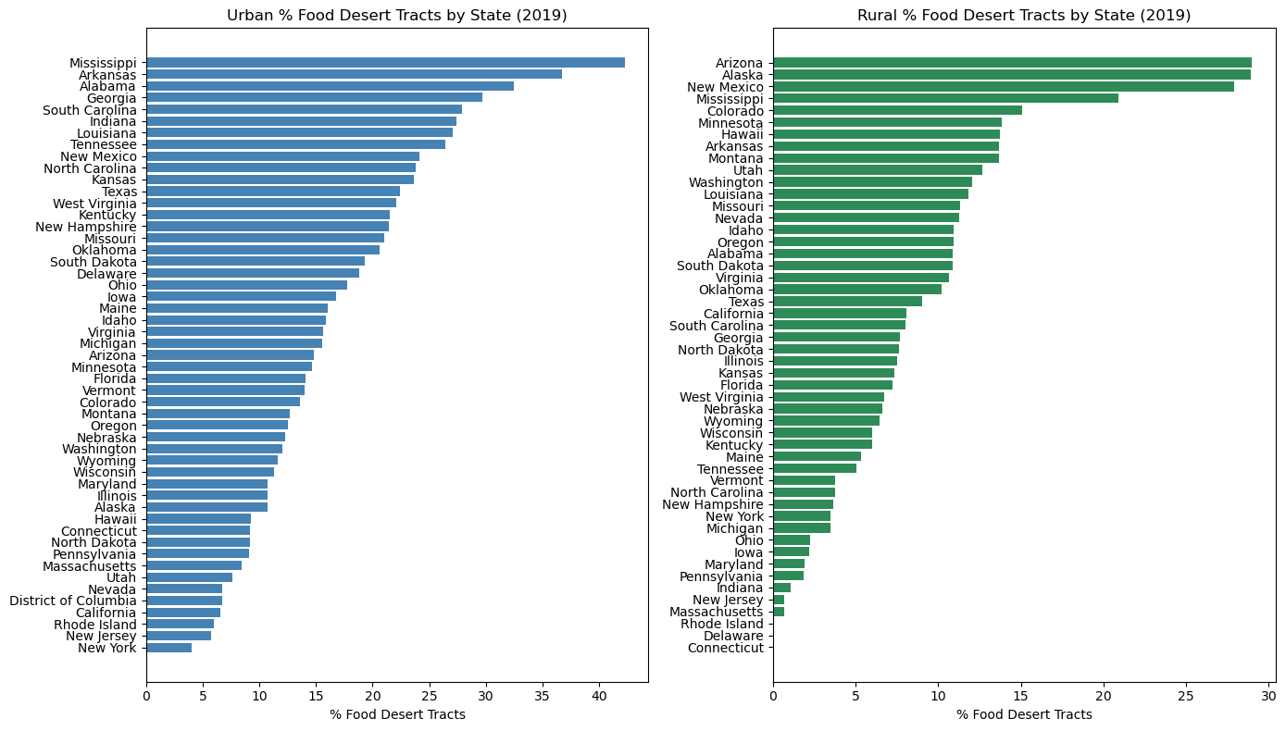

Slide 10
Observations
By far Texas has the most number of food deserts, but Mississippi has the largest percentage of food desert tracts.
States in the southeast have highest concentrations of urban food deserts (MS, AR and AL).
States in the southwest region have the highest number of rural food deserts (AZ and NM). Also, AK and MS.
Notes:
Joyce

Slide 11
SMART Question 2 What demographics and socioeconomic factors are linked to food deserts?
Need to look at supplementary datasets containing Food Environment factors
Merge all datasets using CountyFIPS code
Iteratively eliminate features
Plot correlation matrix and determine main factors linked to food deserts
Remember that correlation does not imply causation!!
Notes:
Joyce

Slide 12
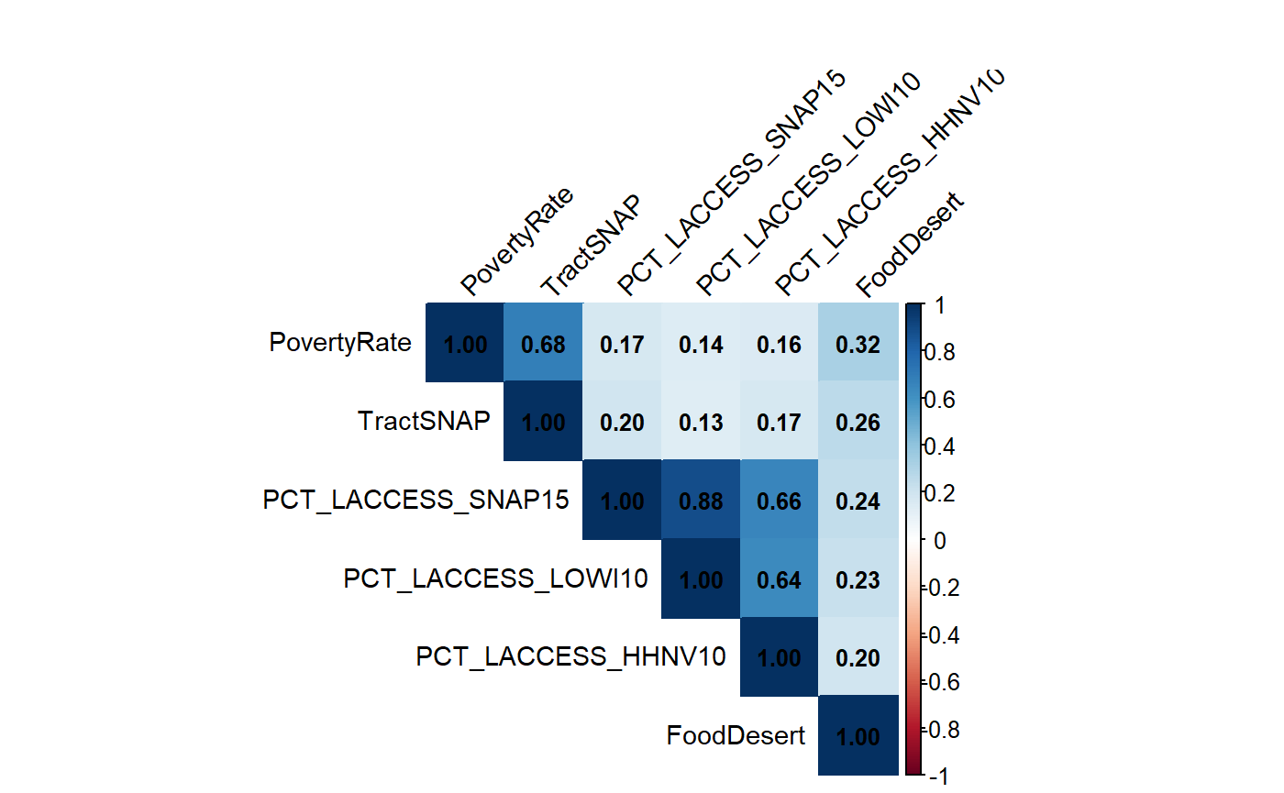

Slide 13
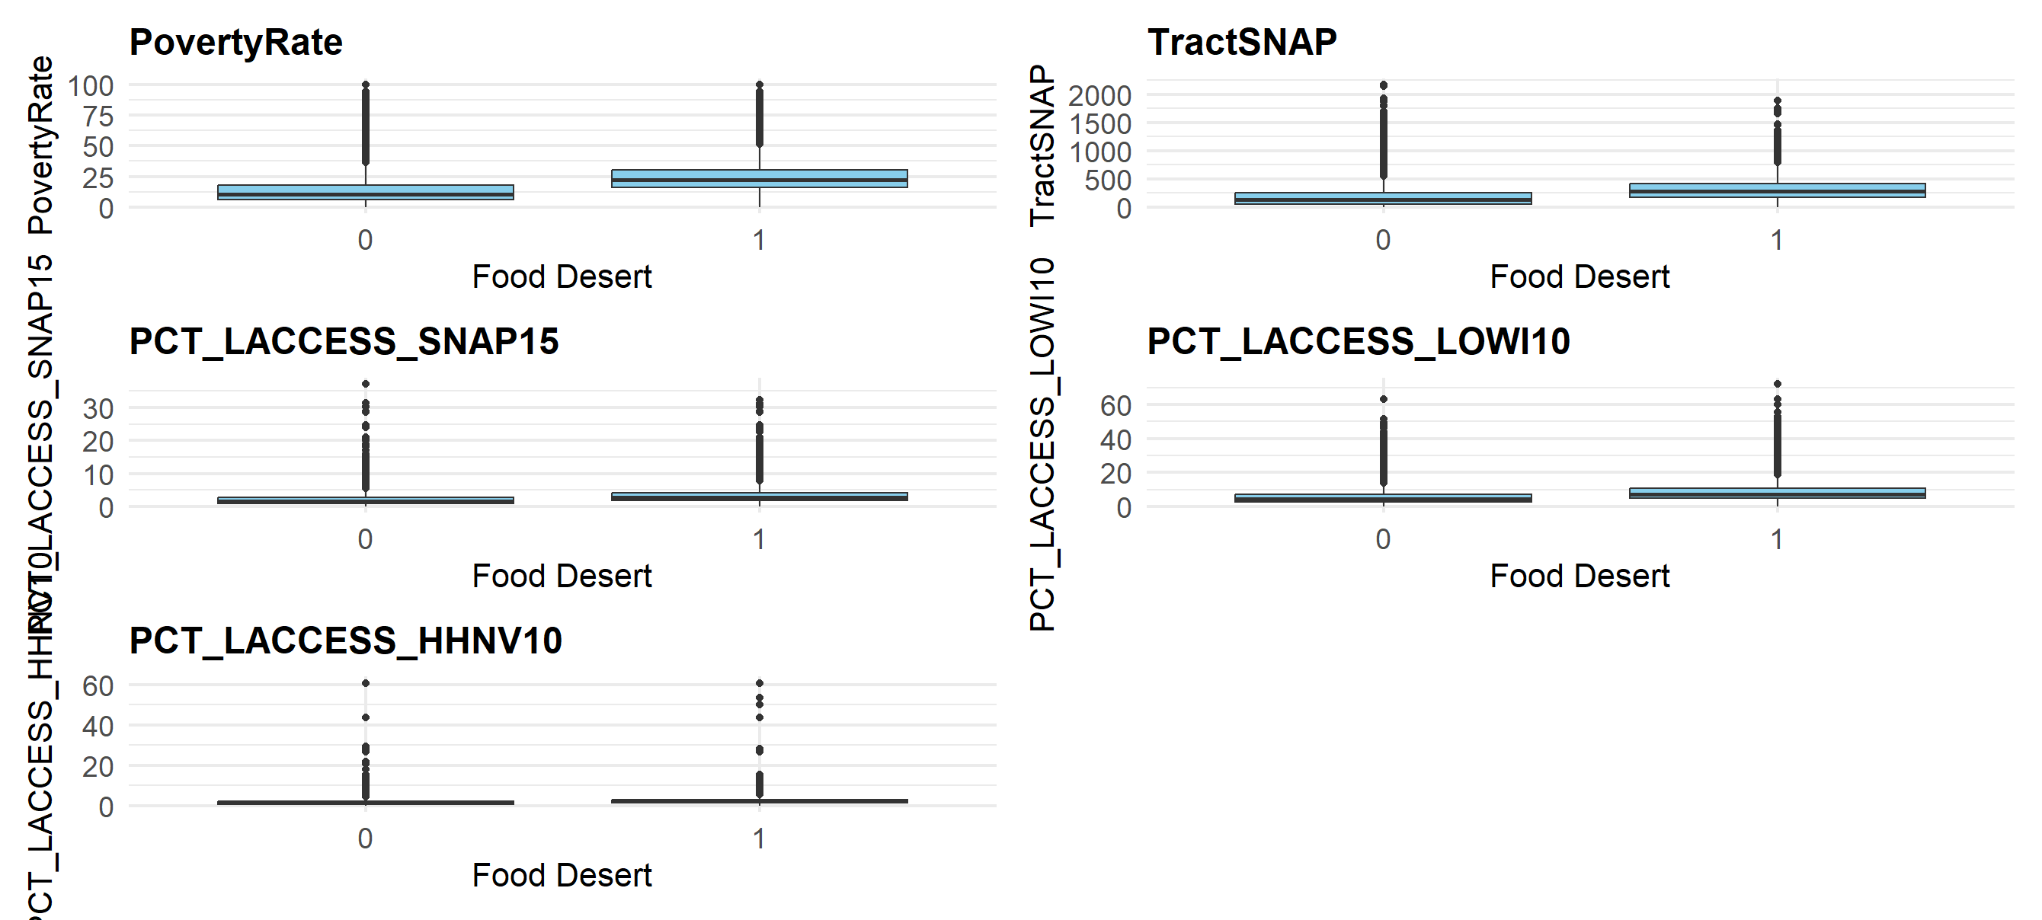

Slide 14
Key Indicators for identifying food deserts
Variable | Correlation value | Description
PovertyRate | 0.32 | % population below poverty line
TractSNAP | 0.26 | # of people on SNAP benefits
PCT_LACCESS_SNAP15 | 0.24 | % of SNAP recipients with low access to stores
PCT_LACCESS_LOWI10 | 0.23 | % low-income people with low access (10 mile threshold)
PCT_LACCESS_HHNV10 | 0.2 | % households without a car and low access
Notes:
Joyce

Slide 15
SMART Question 3 How are food deserts related to health issues like obesity and diabetes?
Approach:
Merged food access and environment datasets using tract-level alignment.
Focused on % Food Desert Tracts, Adult Obesity, and Diabetes Rates.
Notes:
Joyce

Slide 16
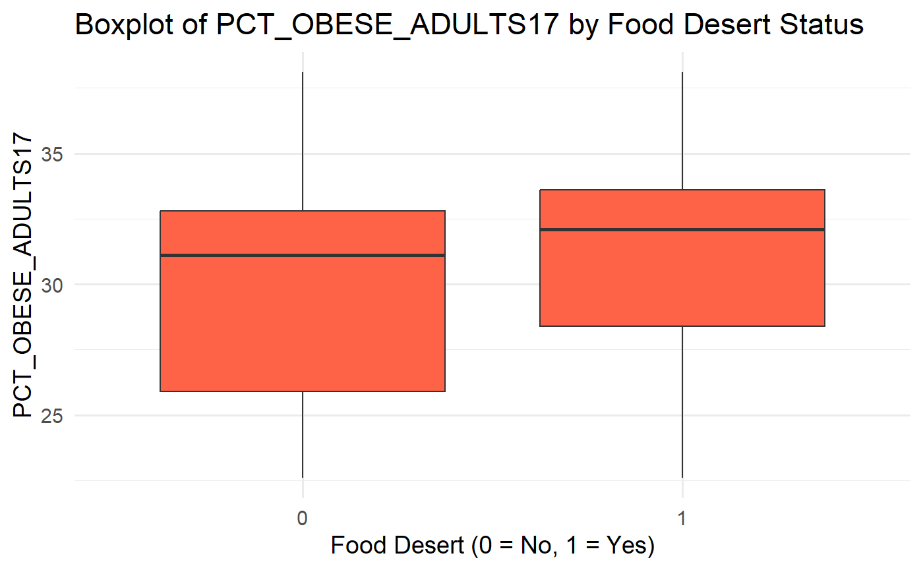
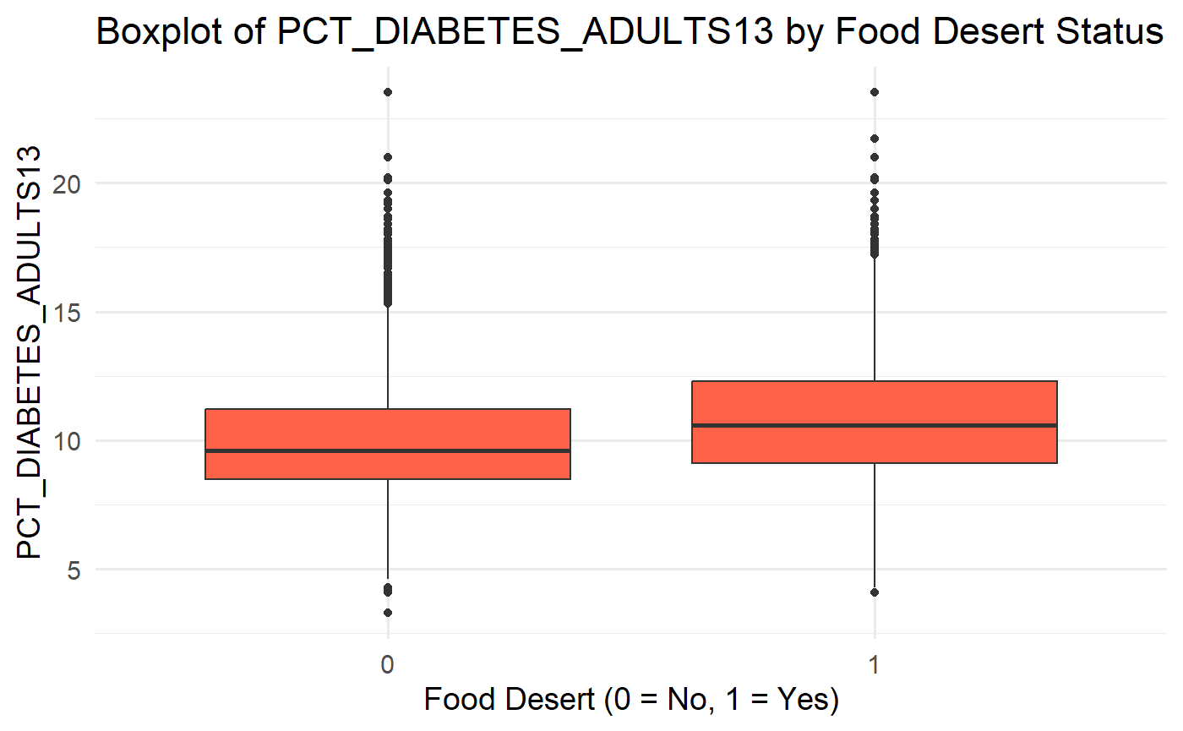

Slide 17
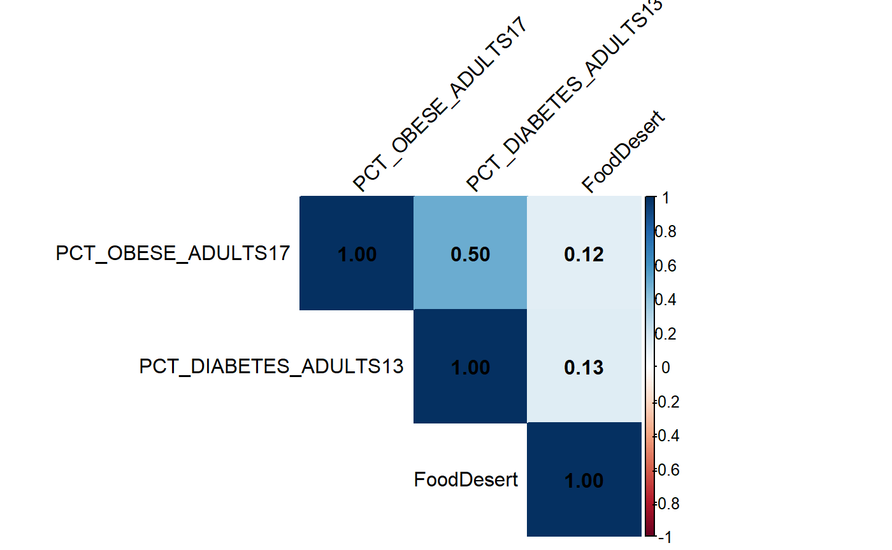
Correlation Table

Slide 18
Observations
Weak correlation between food desert prevalence and health outcomes.
Strong correlation between obesity and diabetes (r ≈ 0.5).
Food access alone doesn't fully explain chronic health disparities.
Implications:
Need to consider affordability, nutrition quality, and health education.
Policies must integrate access with broader public health strategies.
Notes:
Joyce

Slide 19
SMART Question 4 Can we develop a predictive model that accurately identifies high-risk areas likely to be or become food deserts based on social and economic indicators?
We will use the factors that we determined to be highly correlated with food deserts.
Build a logit and RF model.
Analyze the logit model summary.
Compare with RF performance metrics and feature importance.
Notes:
Joyce

Slide 20
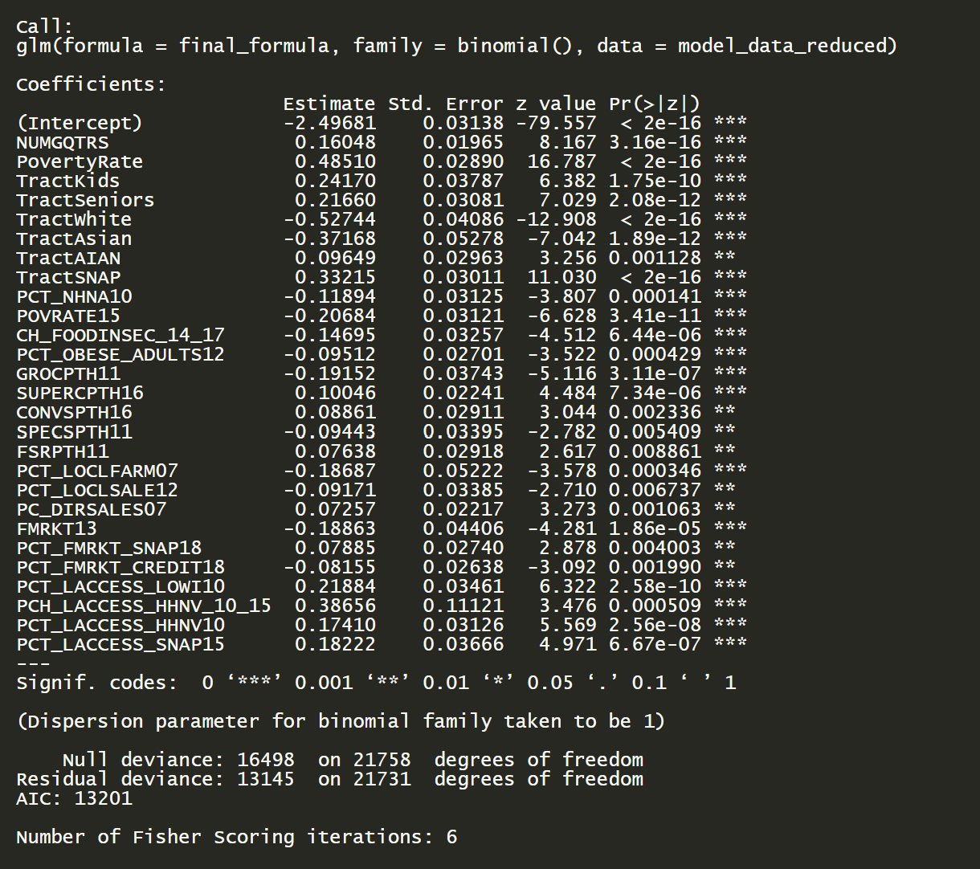
Logit model summary
Notes:
Joyce

Slide 21
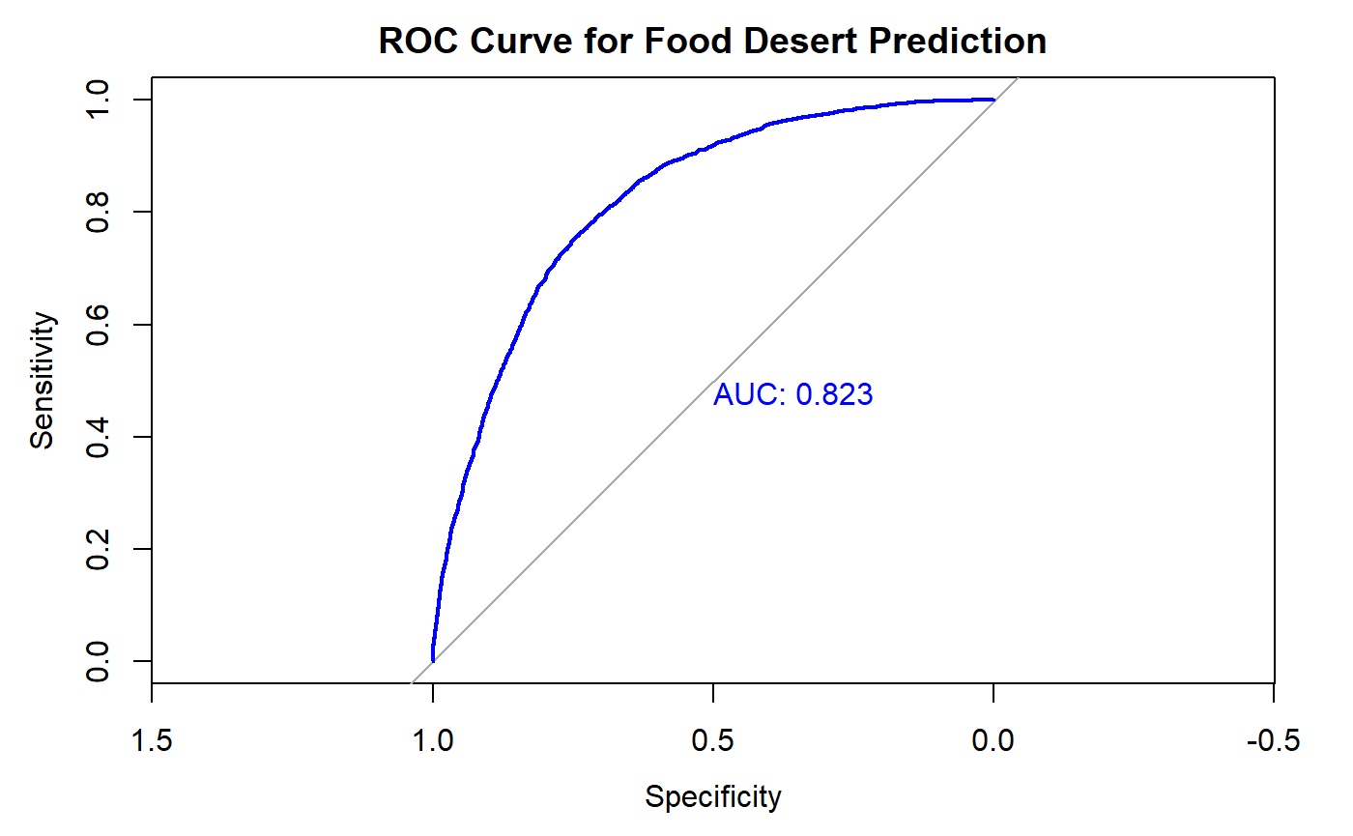
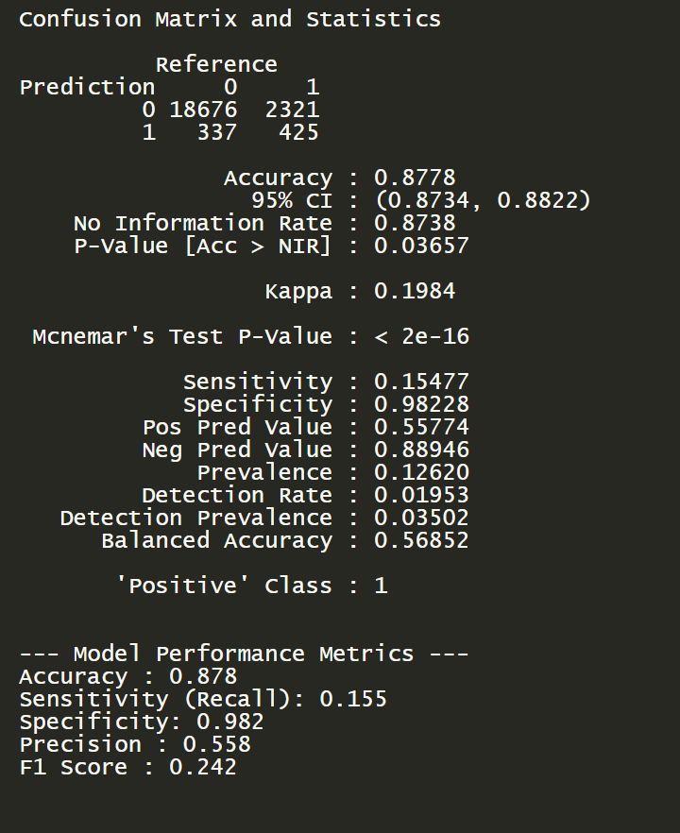
Logit performance metrics

Slide 22
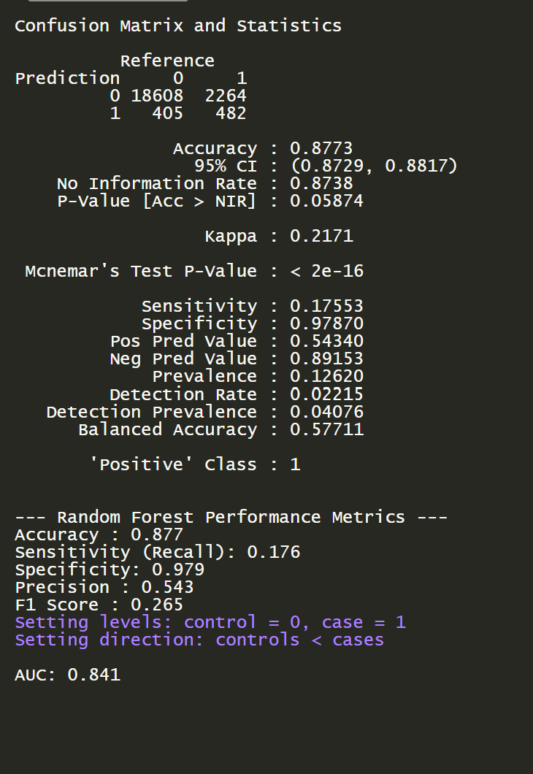
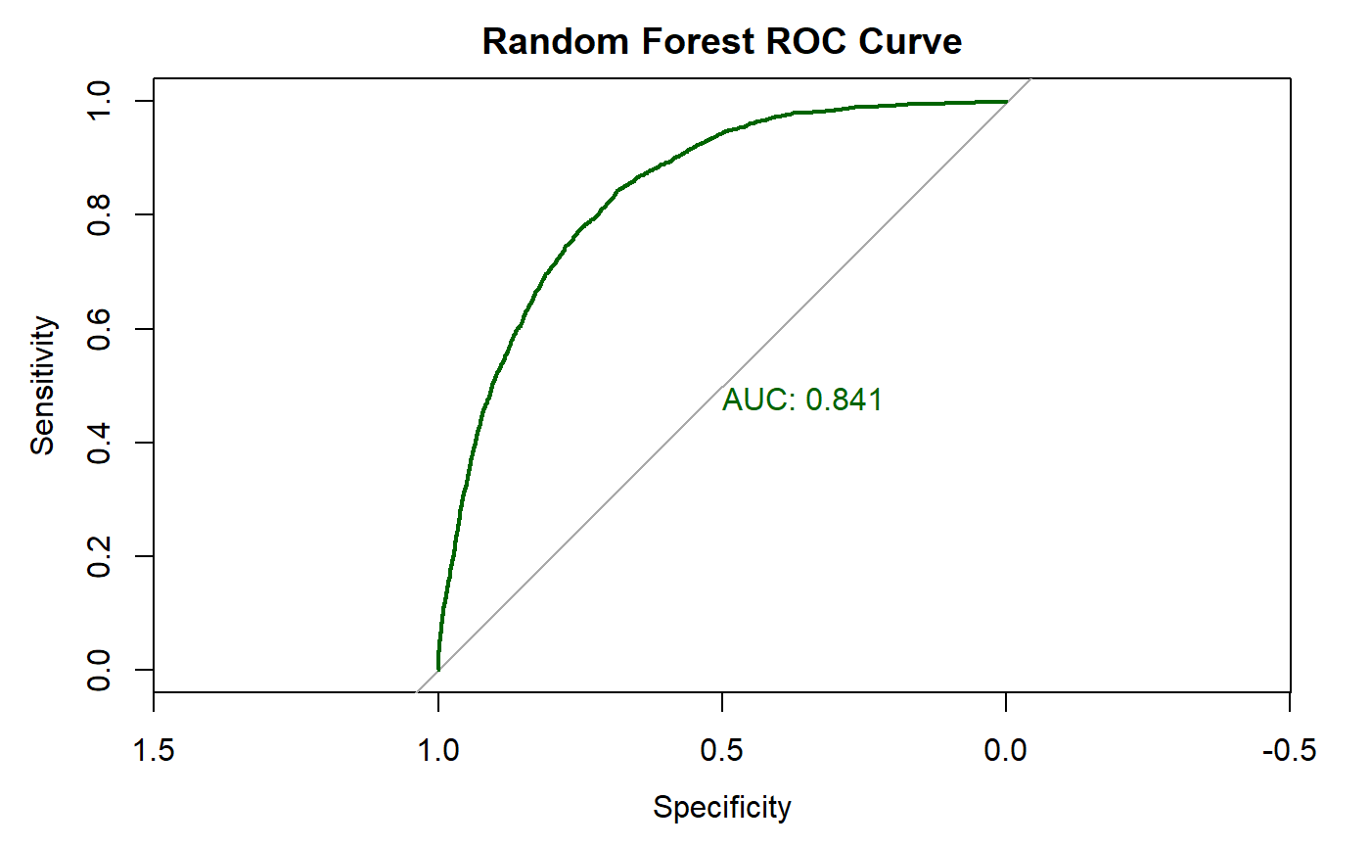
RF performance metrics

Slide 23
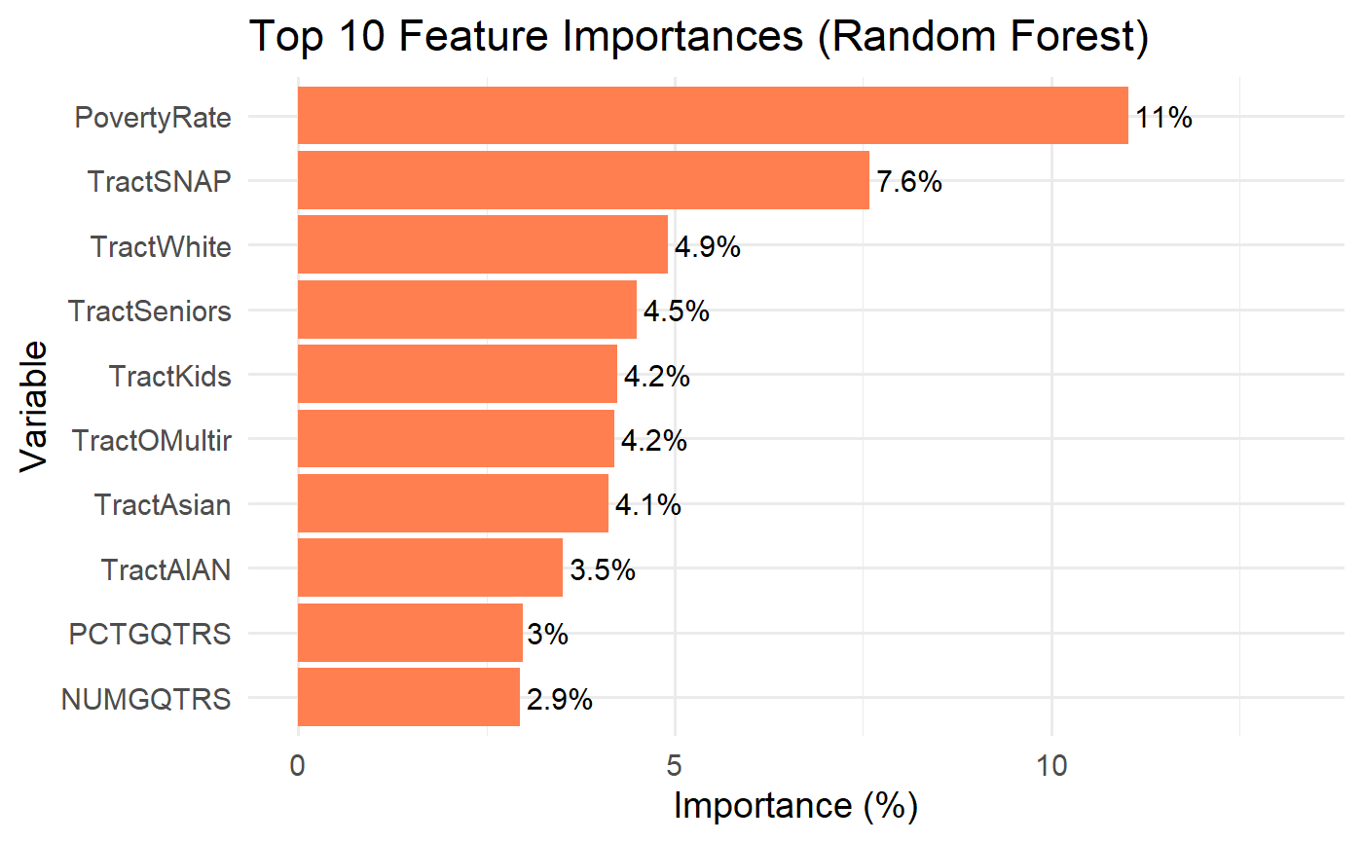

Slide 24
SMART Question 5 What national policies could reduce food deserts based on our findings?
From our modelling exercise, we have found the following factors to be the strongest predictors of food deserts:
LowIncomeTracts
LILATracts_Vehicle
lalowihalfshare
MedianFamilyIncome
lasnap10share
PovertyRate
Notes:
Joyce

Slide 25
Low Income Tracts
Expand the Earned Income Tax Credit (EITC):
Increase the credit for very low-income households and introduce a phase-in stage for families living in federally designated food-desert tracts.
Targeted Workforce Development Grants:
Embed food-desert zone bonuses into Department of Labor training programs, so employers in these areas receive wage subsidies when they hire and upskill local residents.
Notes:
Joyce

Slide 26
Limited Vehicle Availability
Incentivize Mobile Market Operators:
Offer incentives to vendors to serve limited vehicle neighborhoods.
Zero-Fare Public transport routes:
Partner with state transportation services to waive fares on designated public-transit routes connect grocery retailers with food deserts.
Notes:
Joyce

Slide 27
Poverty Rate
Increase Federal Minimum Wage with Geographic Adjustment:
Supplemental “food-access wage credit” to counties with median incomes below the national median.
Affordable Childcare & Transportation Subsidies:
Provide childcare subsidy and commuter assistance in low-income/low-access counties to offset family expenses.
Notes:
Joyce

Slide 28
SNAP enhancements
Nationwide SNAP Online Ordering & Delivery:
Mandate all major grocery chains accept online SNAP purchases and subsidize delivery fees for EBT users in food desert counties.
Mobile EBT Kiosk Grants:
Deploy portable EBT terminals (e.g. at farm stands, pop-ups) throughout rural food deserts to broaden point-of-sale options.
Notes:
Joyce

Slide 29
Key Findings
Food deserts are more prevalent in southern U.S.
1
Strong correlation found between vehicle unavailability and low income with food access
2
Weak correlation between food desert prevalence and health outcomes
3
Notes:
Joyce

Slide 30

Further Considerations
Health outcomes like obesity and diabetes are only weakly correlated with food access alone, highlighting the need for more holistic interventions
Need to build a pipeline to efficiently filter out all the feature list from the supplementary data sources
Will need to investigate the shap values to observe the exact effect on food deserts
Notes:
Joyce

Slide 31



Support or donate to the cause
Thank you
“The test of our progress is not whether we add more to the abundance of those who have much; it is whether we provide enough for those who have too little.” — Franklin D. Roosevelt
nokidhungry.org/donate
give.feedingamerica.org/a/donate

